Slide 1
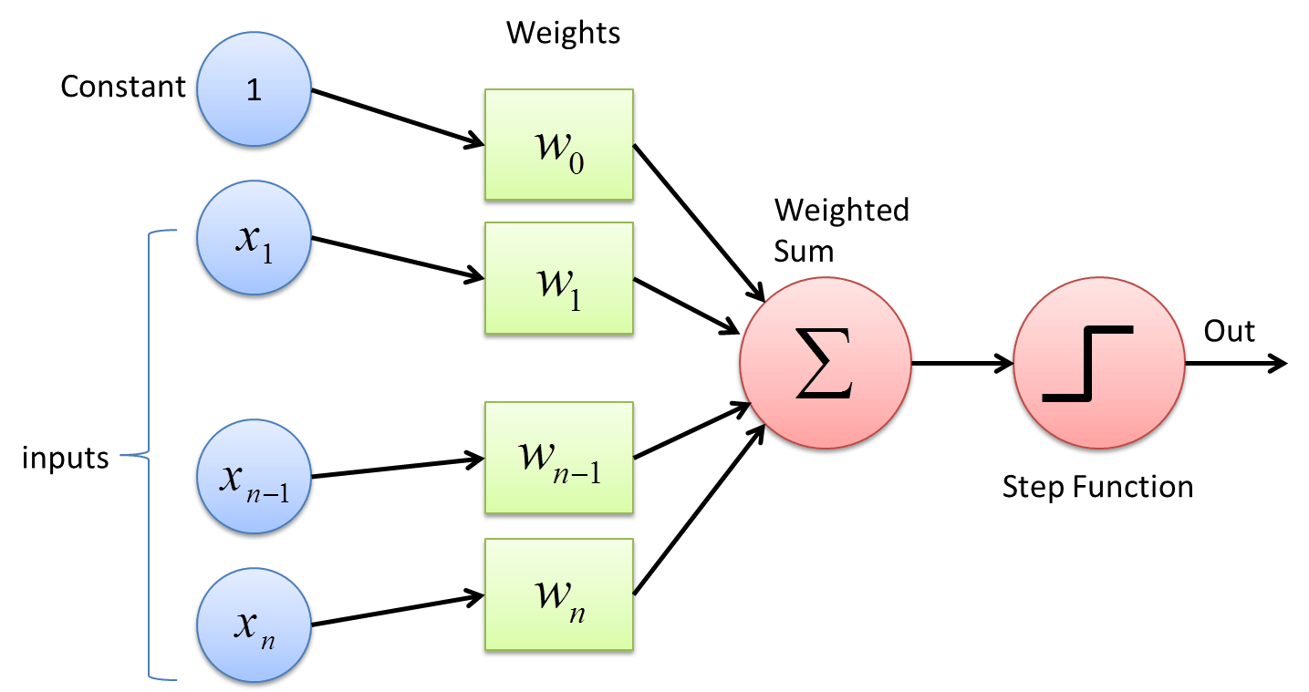
Academy of AI I Perceptron

Slide 2
What is Machine Learning (ML)?
Subfield of Artificial Intelligence
“The field of study that gives computers the ability to learn without being explicitly programmed.” – Arthur Samuel
Older, more informal definition.
“A computer program is said to learn from experience E with respect to some class of tasks T and performance measure P, if its performance at tasks in T, as measured by P, improves with experience E.” – Tom Mitchell
Modern, more formal definition.

Slide 3
Where is ML used?
NLP for text recognition
Self-driving cars
Financial trading
Cybersecurity and data security
Healthcare
Marketing personalization
Fraud detection
Online search
Recommendations
Virtual assistants

Slide 4
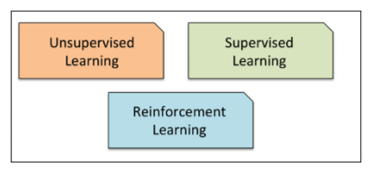
Types of machine learning

Slide 5
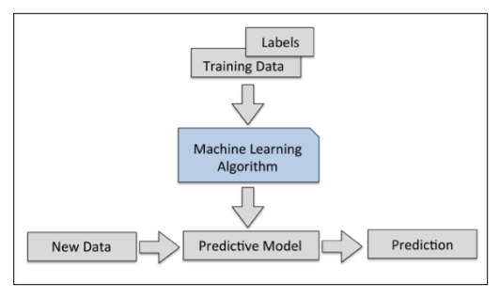
Supervised learning

Slide 6
The ML roadmap
There are three important parts to building any ML model
Pre-processing – In this step, we organise our data in such a way that maximises this efficiency of our machine learning algorithm
Training and selecting the model – Different models perform best under certain conditions, so we ought to know which model is best to utilise
Evaluating models – To be confident in our model’s performance, we must test it on new data
Today, we will try this with the perceptron.

Slide 7
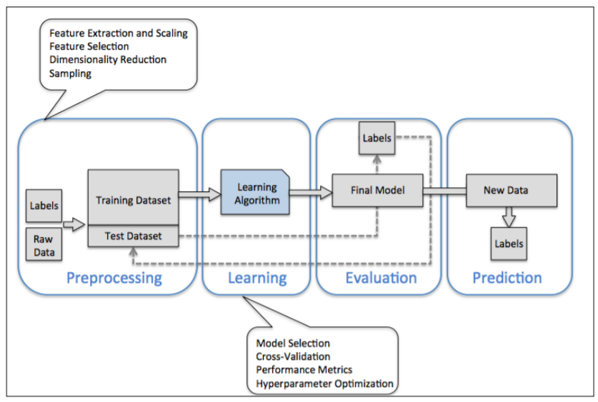
The ML Roadmap

Slide 8
Classification
Subcategory of supervised learning, i.e. relevant in perceptron
The goal is to predict categorical class labels of new data based on previous data used for training the model
Classic example is a spam email filter that groups new emails into two distinct categories: ‘Spam’ and ‘Not Spam’
Can be more than two categories – ‘multiclass classification’ includes handwriting recognition

Slide 9
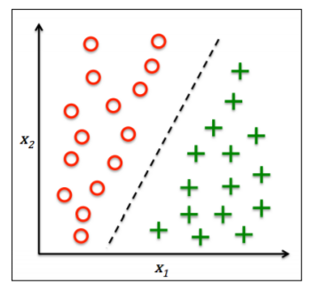
Binary classification
This figure illustrates binary classification
Dots represent one class of data – i.e. ‘Spam’ email
Crosses represent another class – i.e. ‘Not Spam’ email
We want to find the dashed line that divides these two datasets so we can easily classify new data

Slide 10
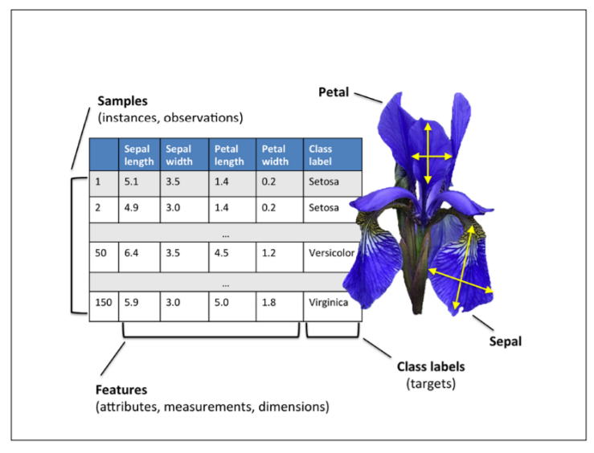
Basic terminology and notation
We will begin by using the ‘Iris’ dataset to train our models
This contains measurements of 150 Iris flowers from three different species – Setosa, Versicolor and Virginica
Each sample is one row of the data
The columns are called features

Slide 11
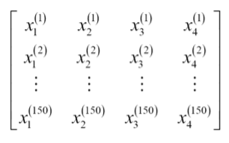
Mathematical Aside
For the mathematically inclined: we can organise the Iris dataset’s 150 samples into a 150x4 matrix
Henceforth in mathematical asides, we will use the superscript i to refer to the ith training sample and the subscript j to refer to the jth dimension of the training dataset
Do not worry about this if it is new!

Slide 12
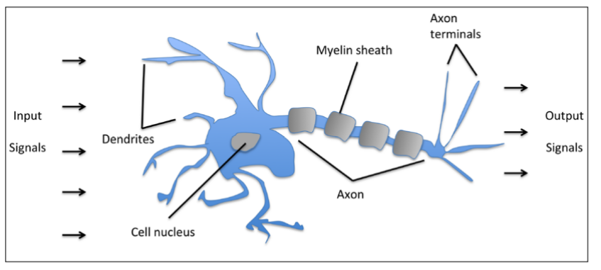
Artificial Neurons
Perceptron is based on the Artificial Neuron
Input signals are multiplied by optimised ‘weight coefficients’
If the result is greater than a threshold, the neuron fires
Finding the optimised weight coefficients is the task of Perceptron

Slide 13
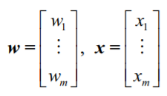
Mathematical Aside How does Perceptron work?
Let’s maintain our binary classification system of two classes: 1 (positive class) and -1 (negative class)
Define a decision function φ(z) that takes a linear combination of input values x and a corresponding weight vector w

Slide 14
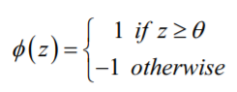

Mathematical Aside How does Perceptron work?
Now define $z=w^{T}x$ i.e. $z=w_{1}x_{1}+w_{2}x_{2}+…+w_{n}x_{n}$
Define our decision function φ(z) as follows

Slide 15
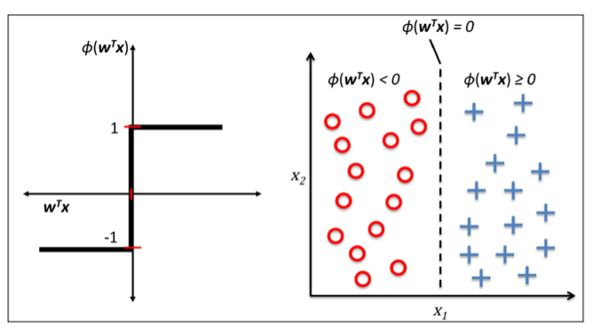
Visualising Perceptron Theory

Slide 16
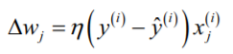
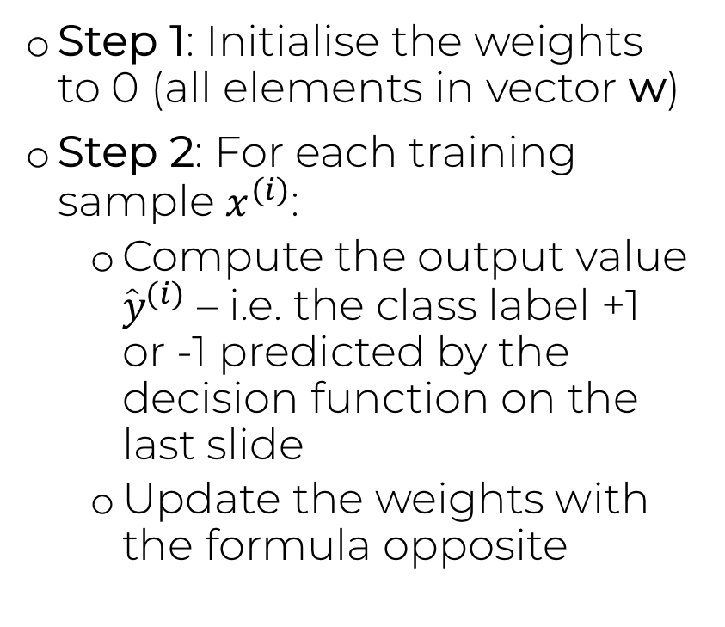
Perceptron Learning Rule
Step 1: Initialise the weights to 0 (all elements in vector w)
Step 2: For each training sample $x^{(i)}$:
Compute the output value ${y\text{̂}}^{(i)}$ – i.e. the class label +1 or -1 predicted by the decision function on the last slide
Update the weights with the formula opposite

Slide 17
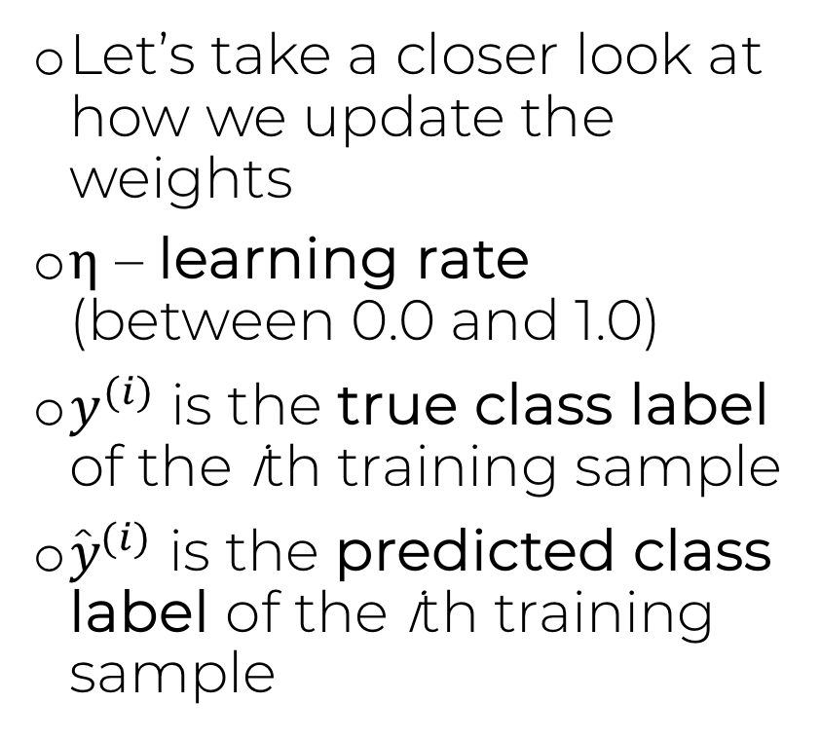
Perceptron Learning Rule
Let’s take a closer look at how we update the weights
η – learning rate (between 0.0 and 1.0)
$y^{(i)}$ is the true class label of the ith training sample
${y\text{̂}}^{(i)}$ is the predicted class label of the ith training sample

Slide 18
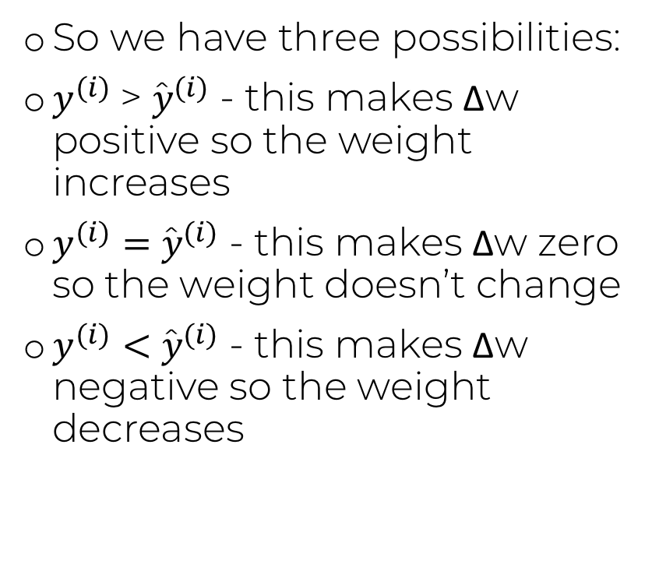
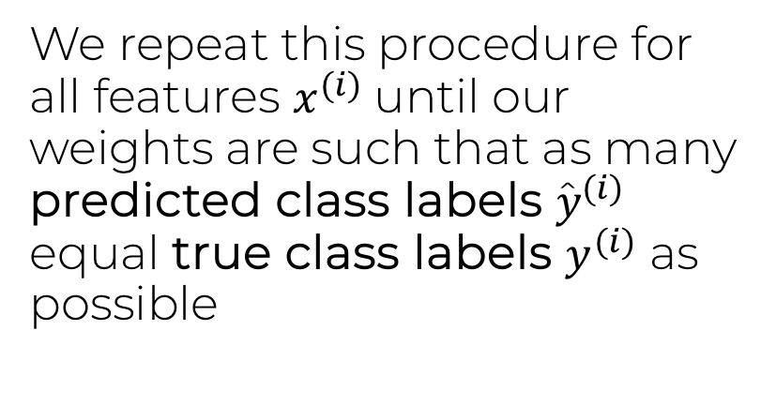
Perceptron Learning Rule
So we have three possibilities:
$y^{(i)}$> ${y\text{̂}}^{(i)}$ - this makes Δw positive so the weight increases
$y^{(i)}=$ ${y\text{̂}}^{(i)}$ - this makes Δw zero so the weight doesn’t change
$y^{(i)}<$ ${y\text{̂}}^{(i)}$ - this makes Δw negative so the weight decreases
We repeat this procedure for all features $x^{(i)}$until our weights are such that as many predicted class labels ${y\text{̂}}^{(i)}$ equal true class labels $y^{(i)}$ as possible

Slide 19
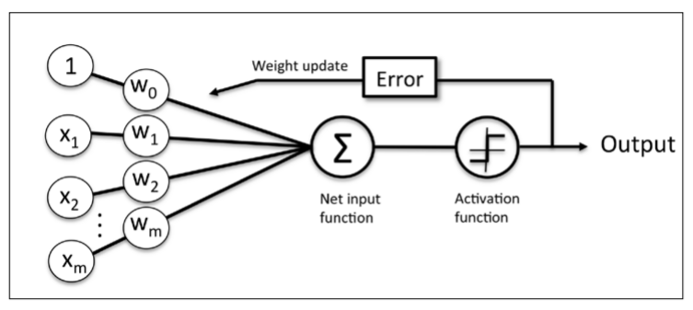
Perceptron Learning Rule
This is the ‘flowchart’ of the Perceptron training model
Features x are multiplied by weights w to give a predicted class value and the weights are updated until the predictions match the known results

Slide 20
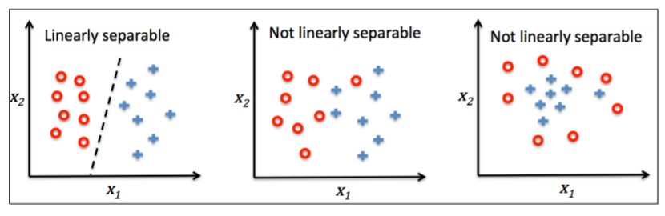
Perceptron Learning Rule
Remember, convergence of Perceptron is only guaranteed if the two classes are linearly separable and if the learning rate η is sufficiently small

Slide 21
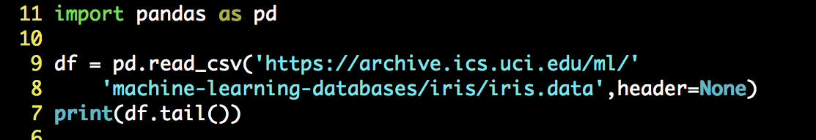
Importing the Iris dataset
Let’s begin with a binary classifier. Here, we use the Pandas library to import our Iris dataset
Read_csv reads the file in the URL provided and imports it into a ‘DataFrame’ – i.e. a set of arrays containing the dataset values
Let’s print the ‘tail’ of the dataset to ensure it imported correctly

Slide 22
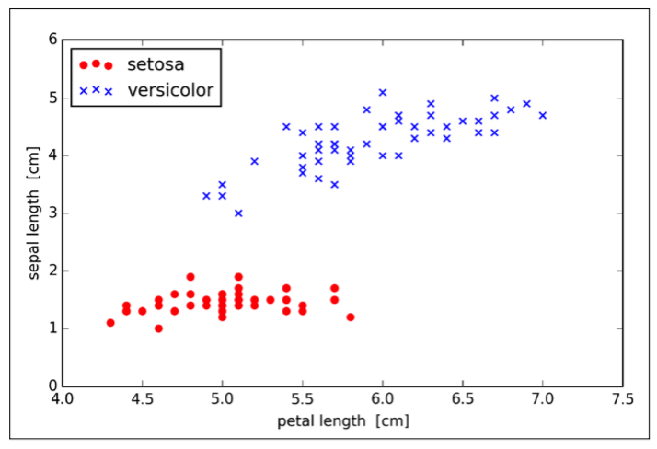
Training Perceptron on the Iris dataset
Here we plot the setosa (dots) and versicolor (crosses) flowers in the dataset.
Note crucially that these two classes are linearly separable! We can draw a distinct straight line between the setosa and versicolor data points. Thus, a linear classifier such as the perceptron should be able to classify the flowers in the binary problem perfectly.

Slide 23
Training Perceptron on the Iris dataset
Now it’s time to do some pre-processing on our dataset before we train the perceptron model
Recall, we need to organise our data in such a way that maximises this efficiency of our machine learning algorithm
Let’s do this by splitting up our Iris dataset into the setosa and versicolor flowers we require for binary classification
The we split up the data into values used for training, and values used for testing…

Slide 24
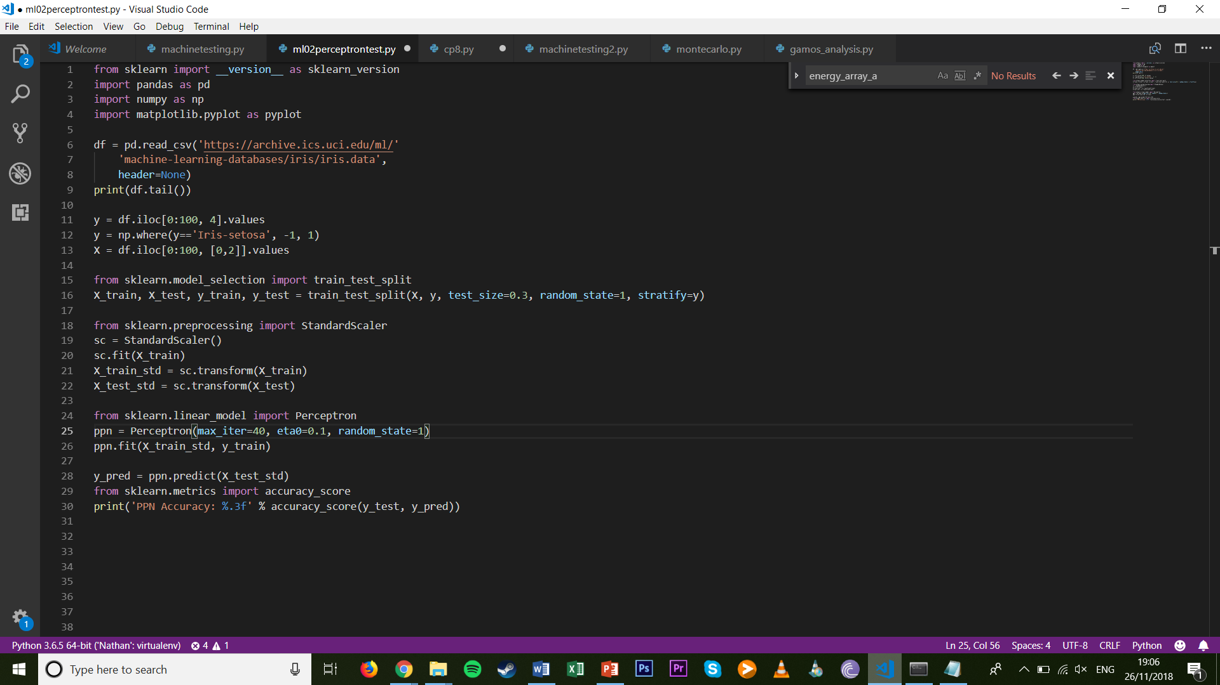
Training Perceptron on the Iris dataset
Type the following into your IDE after you import the Iris dataset…
In the first three lines we pick out the setosa and versicolor flowers and assign them the class labels of -1 and 1 respectively, and then choose the sepal and petal length features
Then we split our dataset into training and test data. Let’s explore this.

Slide 25
Training Perceptron on the Iris dataset
What are we doing here?
We create 4 new datasets from the original dataset
The dataset is split into 30% testing data and 70% training data
X_train is training features and y_train is training class labels
X_test is testing features and y_test is testing class labels
In other words, we train our model on X_train and y_train, and test it on X_test. The results are then compared to y_test to evaluate the model

Slide 26

Training Perceptron on the Iris dataset
Now let’s import our Perceptron class and train it
We perform 40 iterations of weight updates at a learning rate of 0.1
We shall then fit the model on our training data

Slide 27

Evaluating the Perceptron Model
How do we evaluate this model?
Test it on the testing data!
The sklearn.metrics class is useful for determining the accuracy of our model
Run this program and observe the accuracy. Is this good?

Slide 28
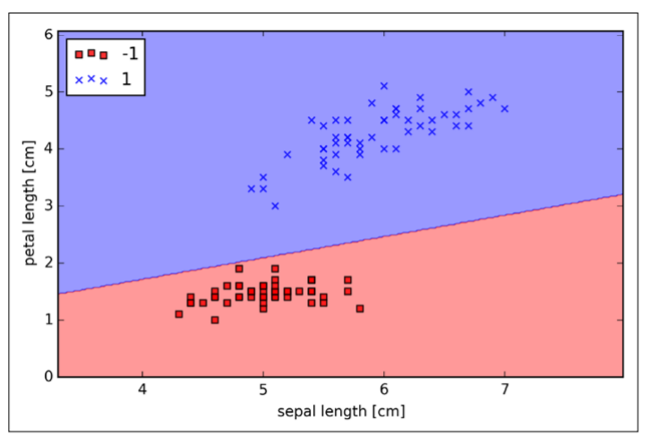
Graphing the Perceptron Model
The perceptron model has successfully linearly separated our Iris dataset
This is the decision boundary that our Perceptron model has found, and is fully accurate for all datapoints
This is too easy. Let’s now try Perceptron with three types of flowers (ternary classification)

Slide 29
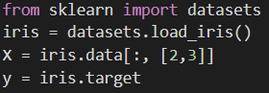
Ternary Classification
We will use the SKLearn library of functions to run our Machine Learning models
Let’s take advantage of the built-in databases to automatically include the Iris dataset in our program (note we redefine X and y!)
In this line we choose the ‘petal length’ and ‘sepal length’ features

Slide 30
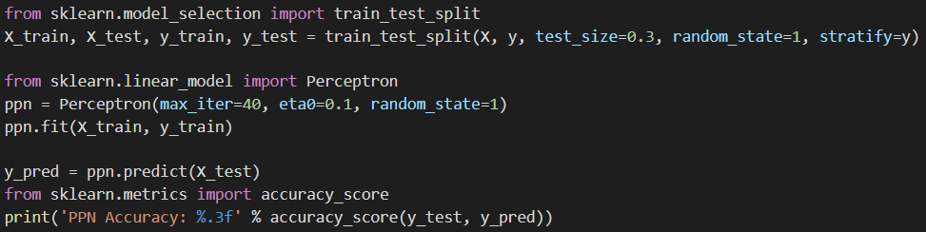
Ternary Classification
Now train the model with Perceptron using the same code as before
Observe the new accuracy of the model – what on earth has happened??

Slide 31
Data Pre-processing
Our new accuracy is low because we have failed to appreciate the significance of good data pre-processing
What we have done so far is throw raw unscaled values into our Perceptron, which negatively impacts efficiency and performance
Let’s remedy this in a simple way: by scaling the data to have an average of zero. This transformation improves computational performance dramatically, as we shall see..

Slide 32
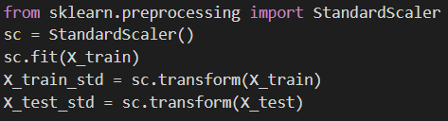
Standard Scaler
Luckily, SKLearn includes functions that can do this for us. Just include the following code in your program after you import the Iris dataset

Slide 33
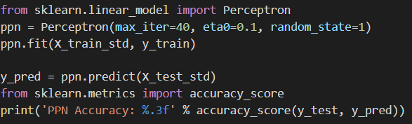
Standard Scaler
Do not forgot to change all X_train to X_train_std and X_test to X_test_std!
Now run your program and observe the accuracy…

Slide 34
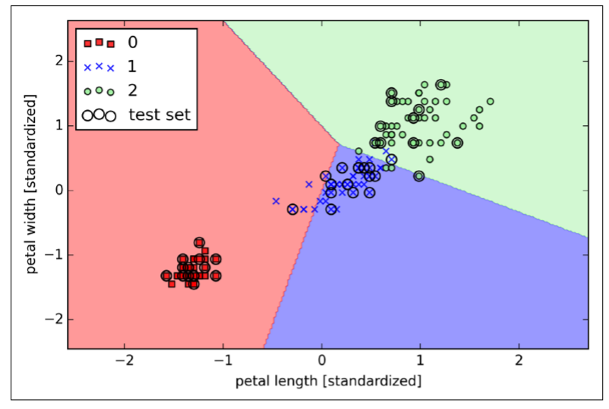
How did we perform?
These are the decision boundaries the Perceptron has found for our ternary classifier
As we have seen, simple pre-processing gives a much more satisfying accuracy!
Notice that it is not perfect. The flowers cannot all be mutually divided by straight lines, so we must settle for some misclassified samples

Slide 35
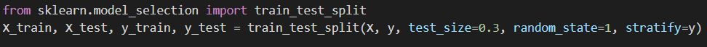
Exercise
Recall that in our training and testing split, we reserved 30% of the data for testing and 70% for training
Change the test_size variable to a different value (between 0.0 and 1.0)
How does the accuracy change? Why does it change? Is there a sweet spot?

